Slide 1

Sustainable Water Resources Management in Nigeria: The Role of Standards Organisation of Nigeria (SON)
Yixing China
19th May, 2025

Slide 2
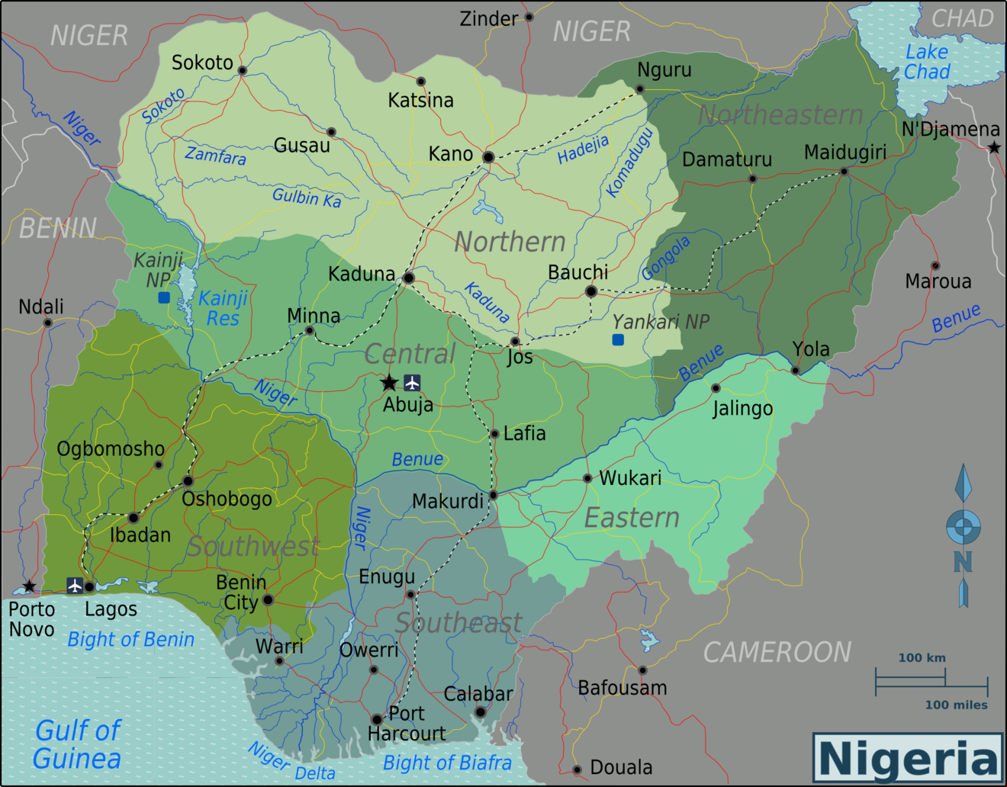
INTRODUCTION
Nigeria, located in sub-tropical Africa with a population of over 200 million, faces growing challenges in water accessibility due to global climate change, variability in rainfall, and rising temperatures. As a developing country, it experiences significant stress in providing clean water to its population.
Freshwater bodies constitute about 13% of the total land area. Nigeria withdraws approximately 4.357% of its total renewable water resources annually, with a groundwater production estimated at 87,000 million cubic meters per year.

Slide 3
INTRODUCTION CONTI….
The country's freshwater system includes extensive surface water bodies such as rivers, lakes, and wetlands. Major waterbodies include the Niger and Benue Rivers, which converge and flow into the Niger Delta. Additionally, Nigeria is divided into eight hydrological zones that encompass numerous tributaries and prominent freshwater lakes such as Lake Chad.
However, increasing climate-induced challenges such as drought, desertification, and the recession of rivers and lakes continue to threaten water availability, posing a major concern for sustainable development.

Slide 4
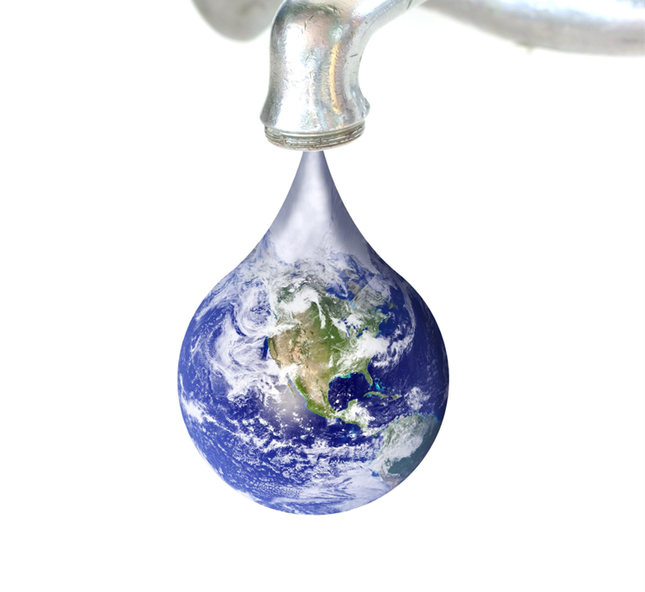
Challenges in Water Management
Impact of Climate Change
Climate change results in unpredictable weather patterns affecting water availability and creating challenges for water management.
Population Growth
Increasing population drives higher water demand, putting pressure on existing water resources and infrastructure.
Water Pollution
Pollution from industries and agricultural runoff leads to degraded water quality and increased water management challenges.
Financial and Infrastructural Issues
Financial constraints and infrastructure problems hinder the implementation of effective water management systems.

Slide 5
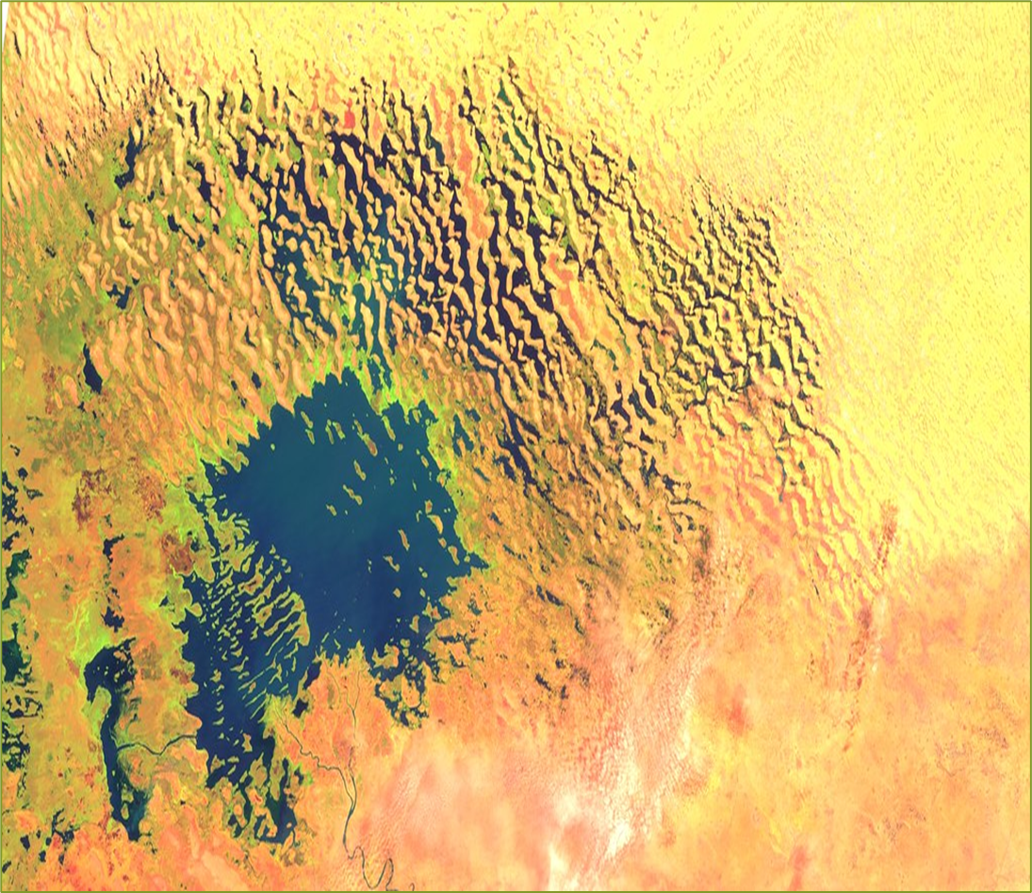
Key Drivers of water shortages
Climate changes
  Drought
  Rivers and Lake Recession
Global warming
  Erratic and Unpredictable rainfall and
  Flooding
Unsustainable water resources management
  Release of used water into the waterbodies
  Linearity usage of water resources
  Improper treatment of waste water
  Citing of industries along water bodies without proper impact analysis
  Farming activities along the boundaries of waterbodies

Slide 6
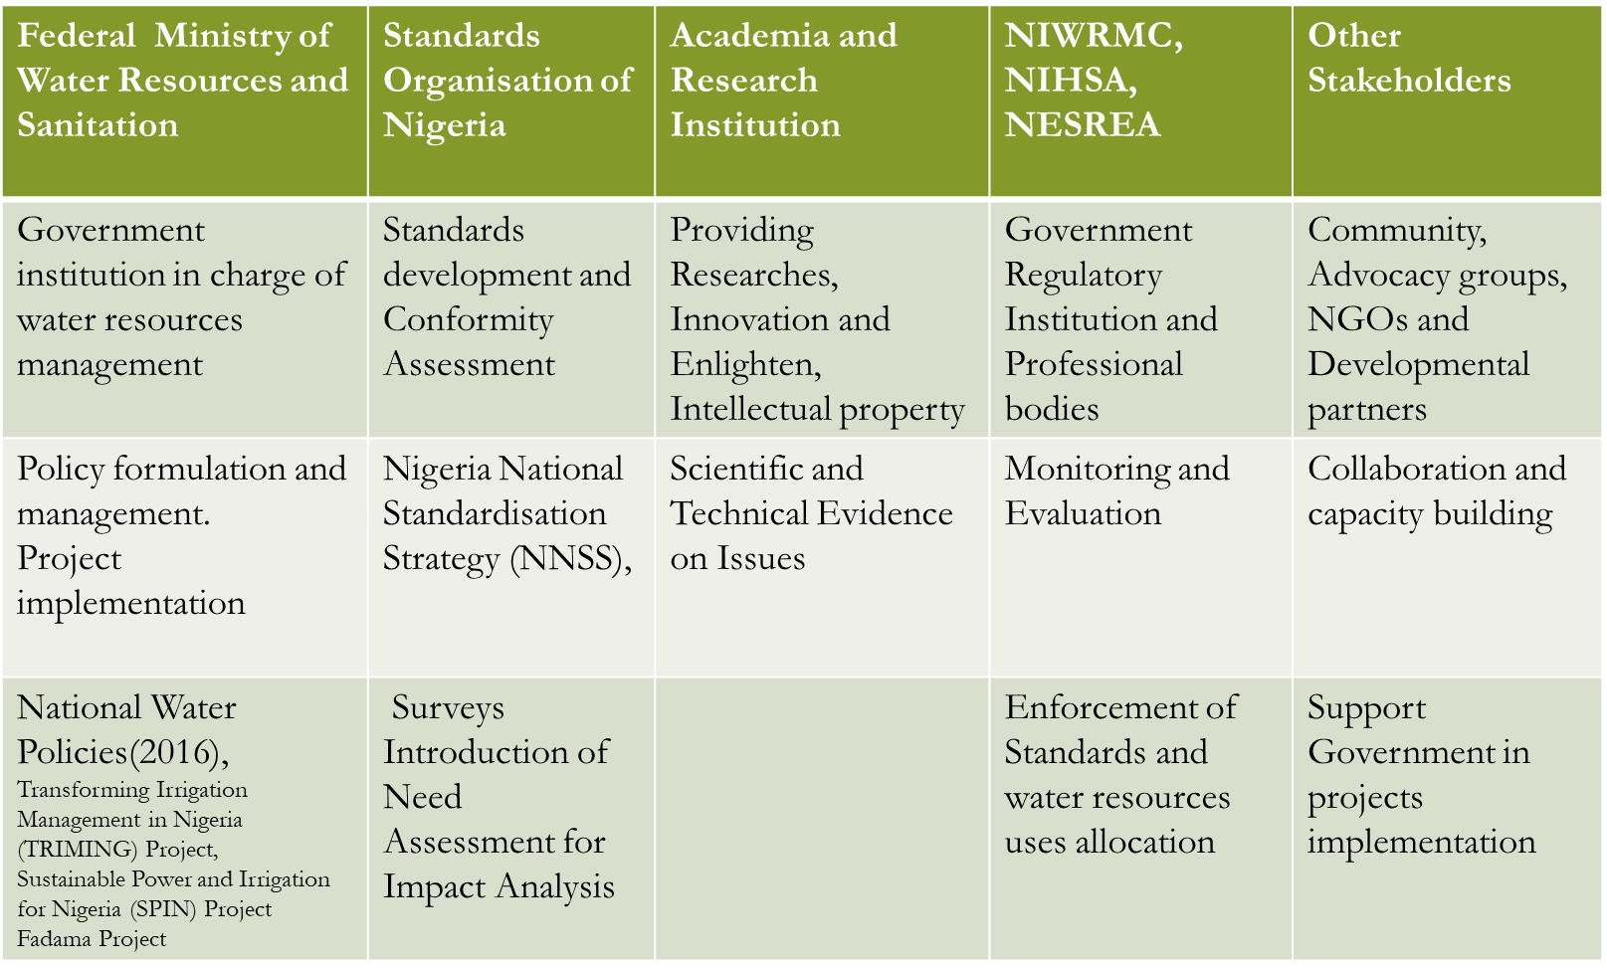
Stakeholders and Governance

Slide 7
The Role of SON in Sustainable Water Resources Management
SON is the apex National standard body Nigeria.
Develops and monitors National Standards.
Assemble experts that participate in standardisation activities at both national and international level through established national mirror/technical committees.

Slide 8
SON CONSTITUTES NATIONAL TECHNICAL COMMITTEES
IN STANDARDIZATION
The categories of relevant stakeholders that constitute each National Technical Committee are drawn from the following sectors:
The Academia
Government Agencies
Research Institutions
Manufacturers and Producers Association
NGOs
Professional Bodies
Business and Trade Groups
Consumers
Quality movements and
other relevant Stakeholders

Slide 9

Conformity Assessment and Water resources management
1
Inspection
2
3
Certification
Laboratory Accreditation
Sampling
Testing
Surveillance
Calibration

Slide 10
SON and International Standardisation
SON has established National Mirror Committee NMC which:
mirrors the activities of ISO TC on Water Quality, Drinking Water and Water reuse.
Currently SON participates in about 138 ISO/TCs
  P-members 86
  O- members 52
SON participate in all the Water TCs
  ISO/TC 282 as P-Member
  ISO/TC 224 as O-member
Adopted many ISO standards on water quality as National standards.

Slide 11
Conclusion:
A circular, sustainable, collaborative and integrated water management approach is key to Nigeria’s future.
Reuse and recycling of water
Strict environmental regulation
Strengthened national standards and compliance monitoring
Continued SON engagement with ISO practices

Slide 12
Thank you

Slide 13
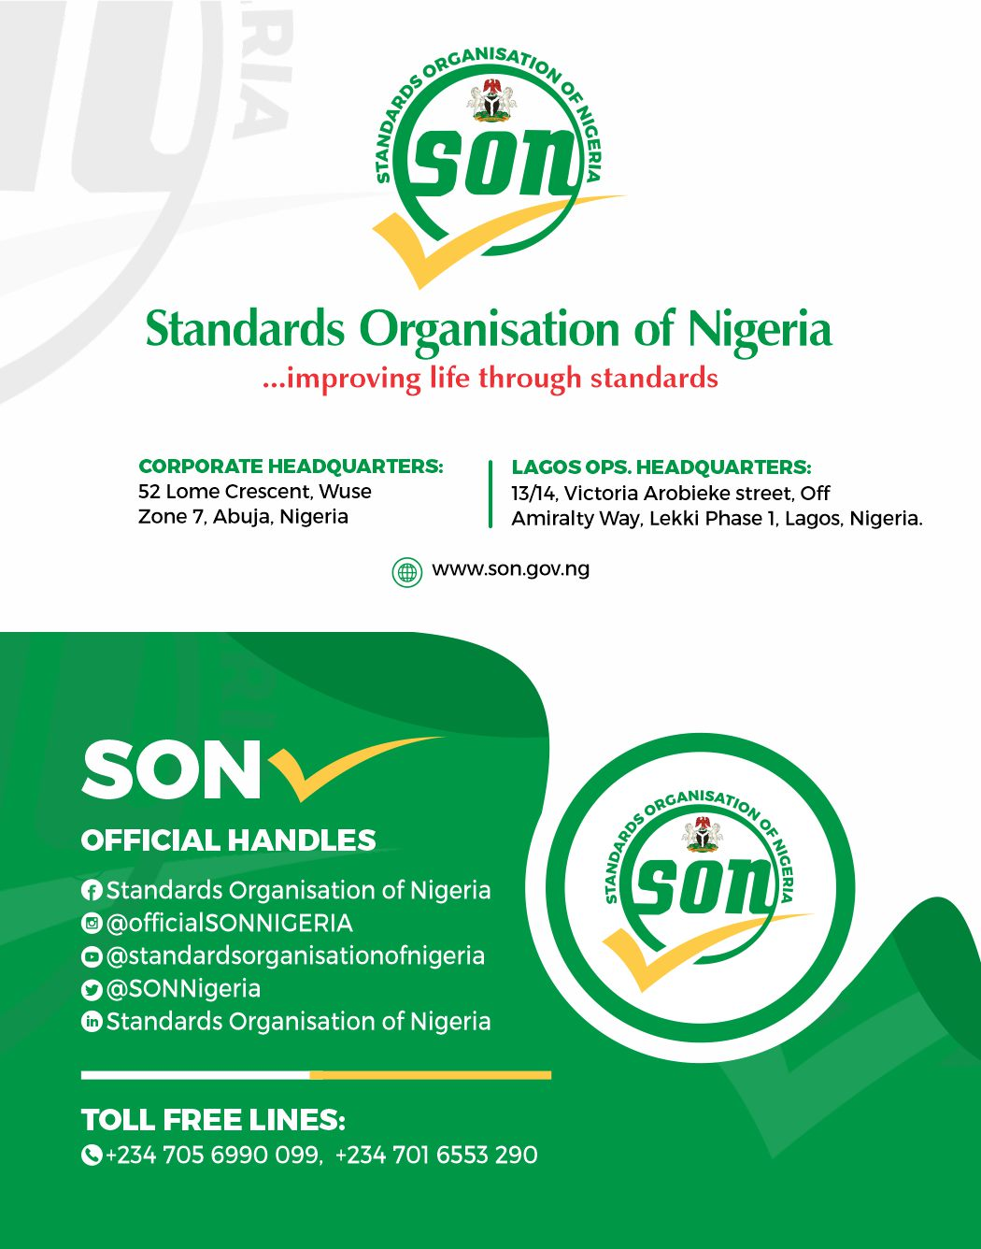
Collaborate with:

